Slide 1
Intuitive Guide to Fourier Analysis and Spectral Estimation
How explore Fourier analysis with Matlab
Charan Langton
Victor Levin
www.complextoreal.com
Copyright C. Langton

Slide 2
Material
We will cover
Fourier series for CT signals
Discrete Fourier series
CT Fourier transform
DT Fourier transform
DFT/FFT
Using DFT to do spectral estimation
Periodogram
Autopower
Matlab code at: http://complextoreal.com/fftguide/

Slide 3
Some acronyms
FA – Fourier analysis
CT – Continuous time
DT – Discrete time
FT – Fourier transform
CE – Complex exponential
FSE – Fourier series equation
FSC – Fourier series coefficients
FT/FFT – Fourier transform

Slide 4
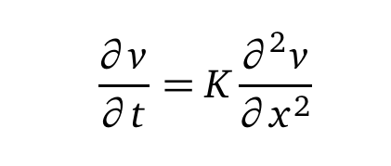
In 1841, Baron Joseph Fourier, a natural scientist, noted while working on a problem relating to heat transfer, that solution to differential equations such as this one
Consisted of a set of harmonic sinusoids.
The whole field of spectral estimation is based on this observation.

Slide 5
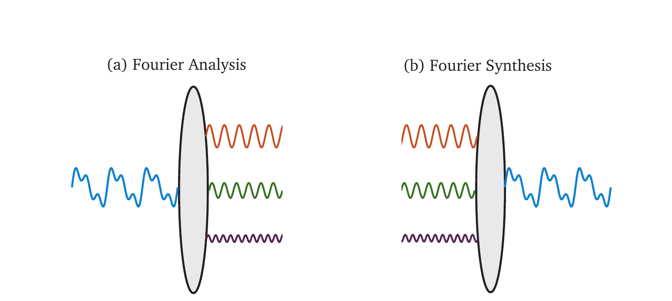
This is Fourier analysis: Taking an unknown periodic signal and representing it by a set of harmonic sinusoids that are related to each other by a concept called harmonics.
Fourier Synthesis: Taking a bunch of selected harmonics, changing their coefficients and phase to create a desired periodic wave.

Slide 6
This signal in Time-domain.
Here is a random looking wave, which is periodic.
It is actually composed of these three sine waves.

Slide 7
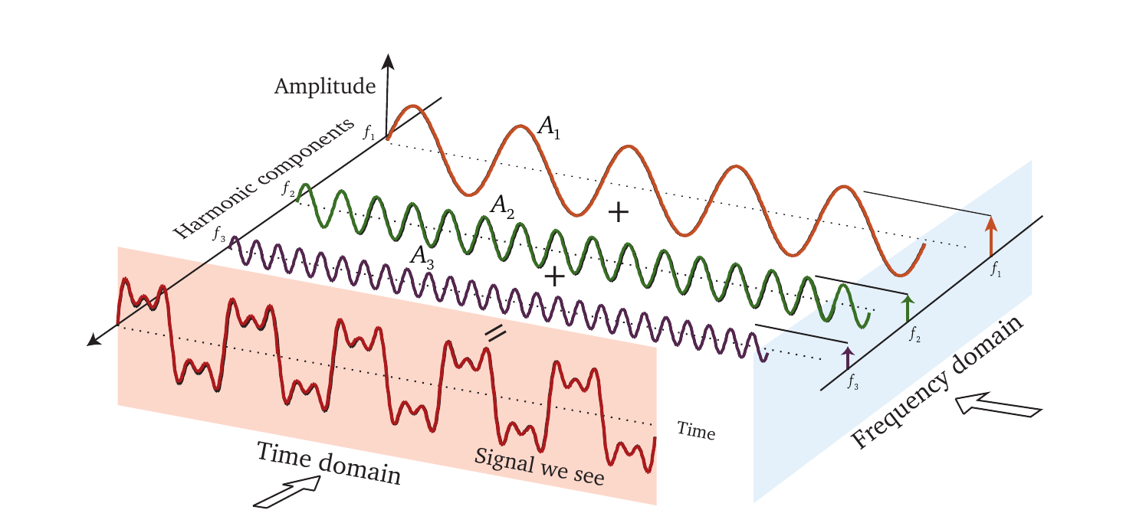
Time and Frequency Domain views of a signal
In time-domain, we write this wave as summation of three sine waves of frequencies 1, 2, and 3 Hz of different amplitudes.
Frequency domain view is called the spectrum of a signal.

Slide 8
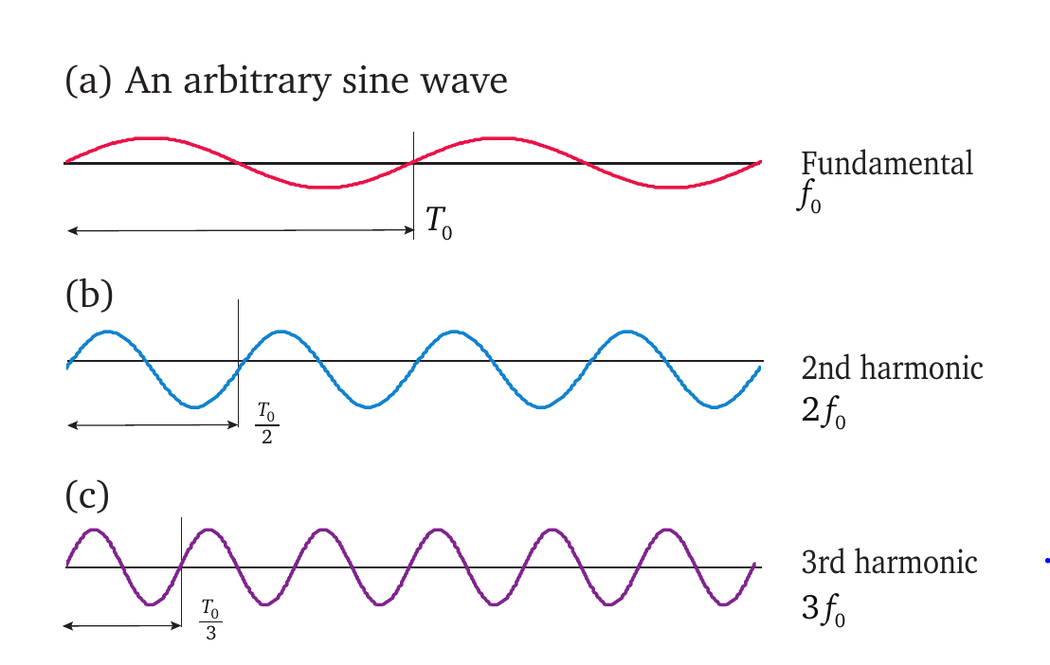
The fundamental frequency and the harmonics (basis functions.)
An arbitrary fundamental wave and its harmonics.
Start with an arbitrary wave of frequency, f₀.
Its second harmonic of frequency 2 times f₀. (c) A third harmonic of frequency 3 times f₀.
Fundamental Frequency: a fundamental concept.
It is the lowest frequency in the target signal.
So to do FA, you have to know the range of frequencies in a signal.

Slide 9
Amplitude and phase
Amplitude
Phase
Phase shift
A sine and a cosine of the same frequency makes a set of harmonics, both have same frequency but are orthogonal to each other. We use both sines and cosines to synthesize a wave.

Slide 10
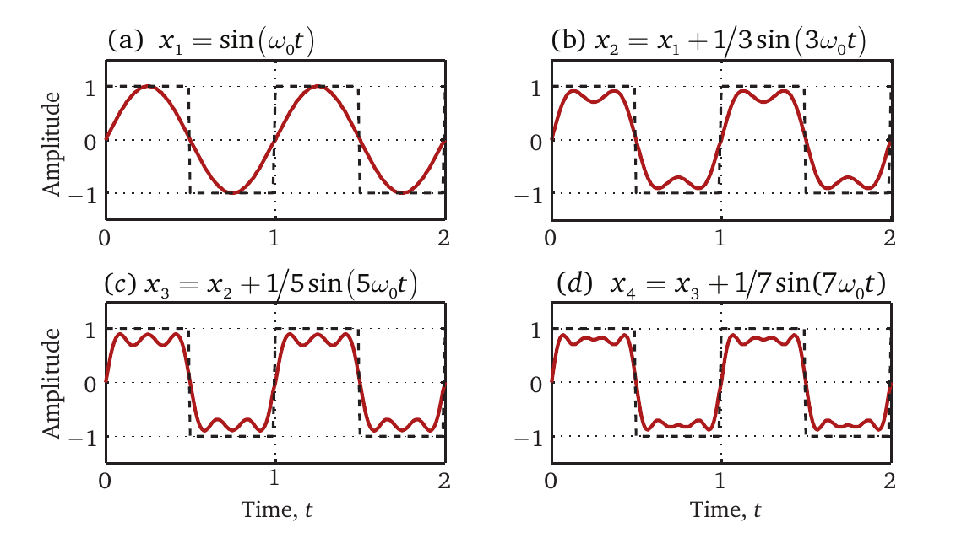
Creating a pretty good-looking square wave by adding a bunch of sinusoids.
Synthesizing waves by adding a bunch of harmonics
If we use only cosines, we get a wave that is “even.”
If we use only sines, we get a wave that is “odd.”

Slide 11
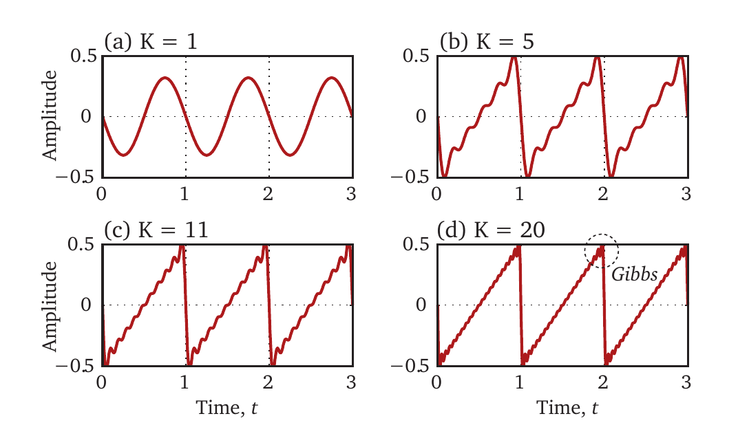
Another example of Fourier synthesis, a saw-tooth wave

Slide 12
Here is the Fourier series equation

Slide 13
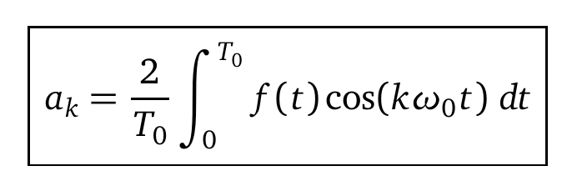
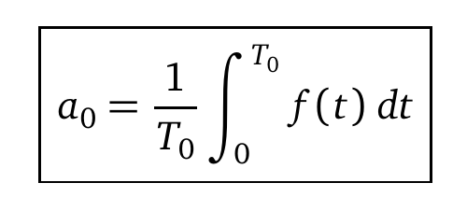
Fourier analysis consists of computing the coefficients of this equation.
They are easy to calculate. Refer to Chapter 1 of Reference book, IGFASA

Slide 14
Simple example: what are the Fourier series coefficients of this signal.

Slide 15
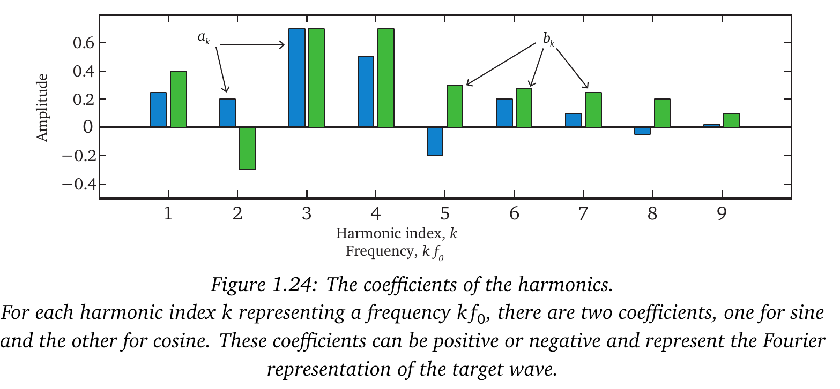
Coefficients become the spectrum

Slide 16
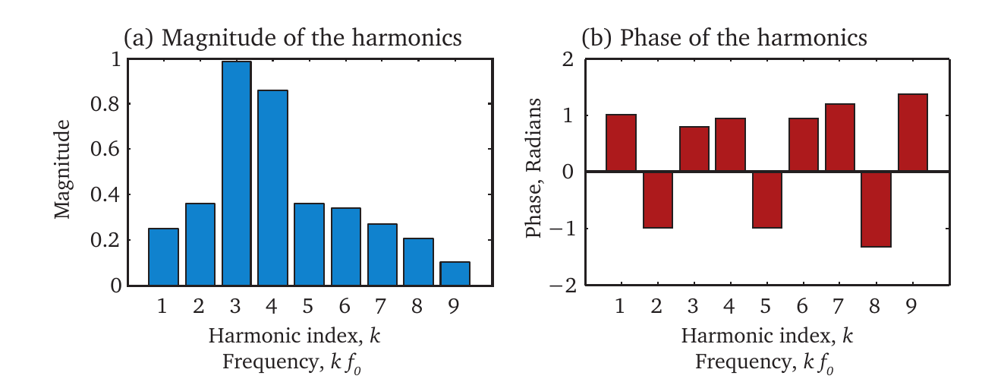
Magnitude and Phase Spectrum

Slide 17
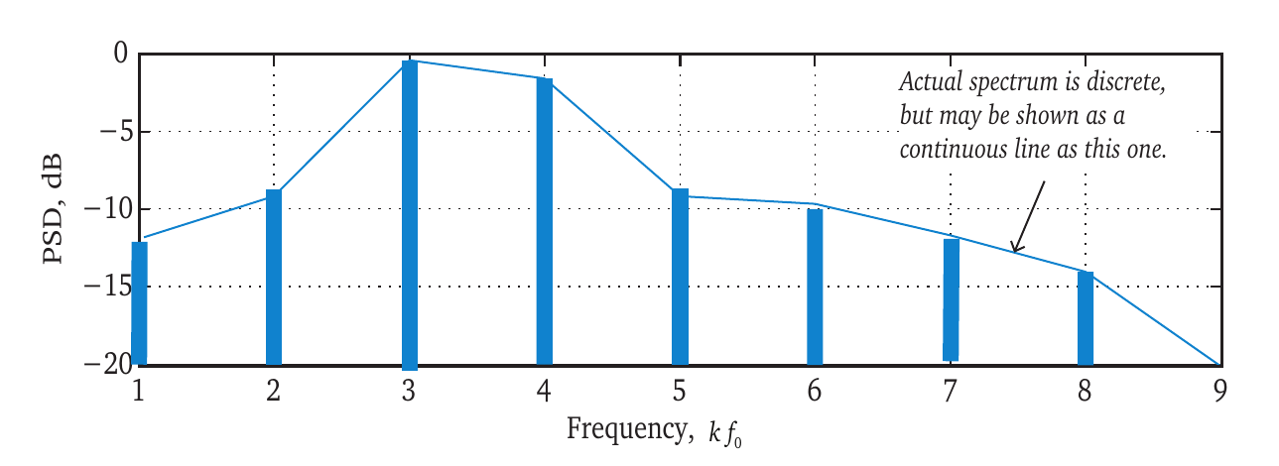
Power spectrum
Square the magnitude to compute the one-sided power spectrum.

Slide 18
Summary
Fourier series is way to represent an un-known continuous-time (CT) periodic signal into certain basis functions. It is an estimate.
These basis functions are harmonic sinusoids of a certain fundamental frequency.
The spectrum of this CT periodic signal is discrete, because the values occur only at integer multiples of the fundamental frequency.
To do the FA, we need to select a starting frequency, called the fundamental frequency, the lowest frequency present in the target signal.

Slide 19
Complex representation of CT signals
What Euler said
This equation is called the Complex Exponential.
Positive CE
Negative CE

Slide 20
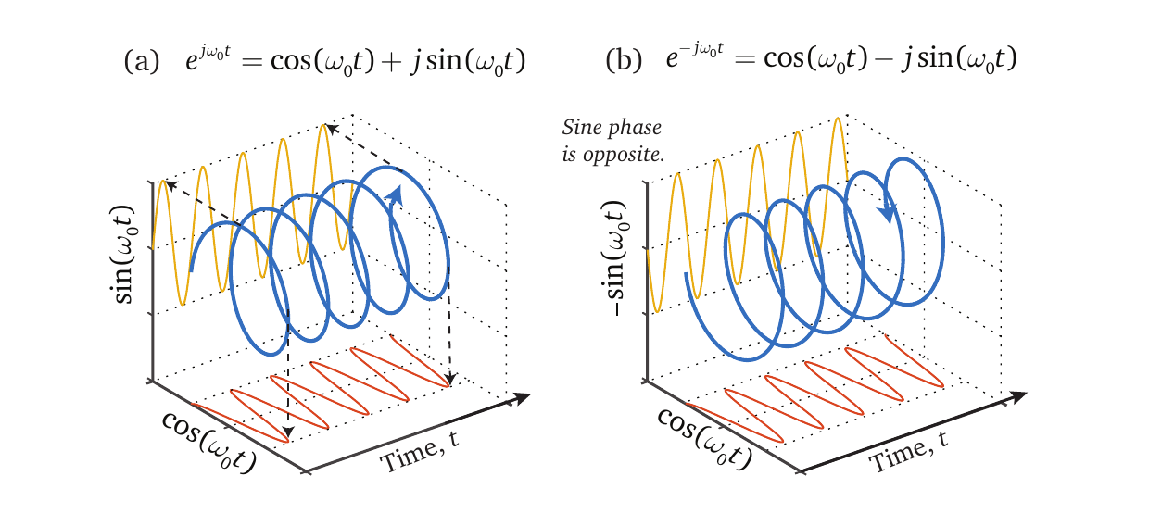
A CE is a 3-D function, a helix. Its projections are sine and cosine.

Slide 21
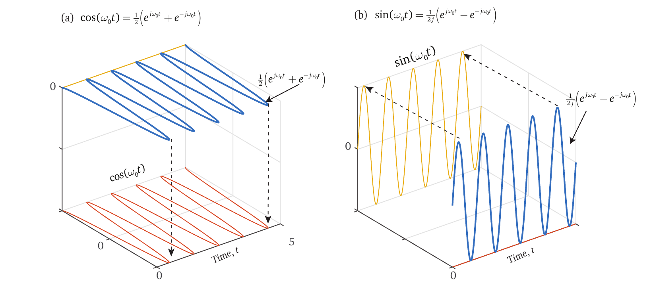
Plotting the sum and the difference of CEs gives us the cosine and the sine wave.

Slide 22
Representing the Fourier series using the CEs
It take two CE to represent a sine and cosine, one with positive index and the other with negative.

Slide 23
Rewriting FSE using CEs

Slide 24
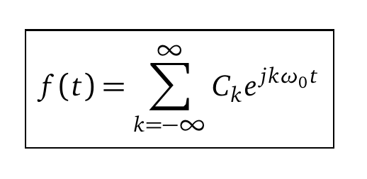
New form of FSE with CEs

Slide 25
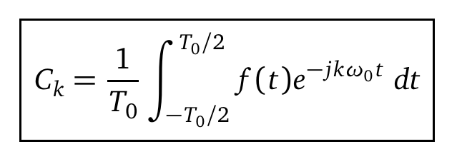
The complex form of the FSE.
The coefficients of the complex form of FS are complex.

Slide 26
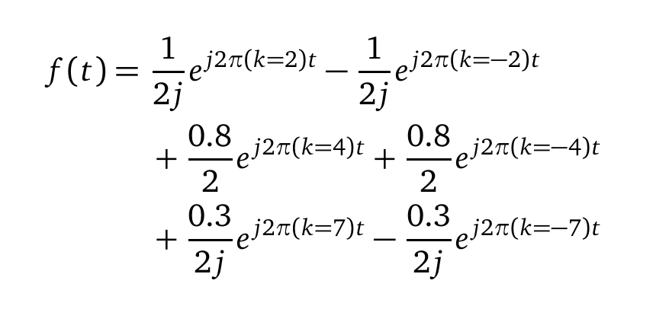
Example: Complex FSC of

Slide 27
FSC of the complex form - summary
The complex form of the FSE is simpler to manipulate than the trigonometric form.
But because it takes a double-sided index to represent a CE, the spectrum of the complex form is two sided.
Does that means, we have magically given birth to negative frequencies now? NO!
There is no such thing as negative frequency!
It is the index that is negative. The x-axis of the spectrum is always k times the real quantity, the fundamental frequency.

Slide 28
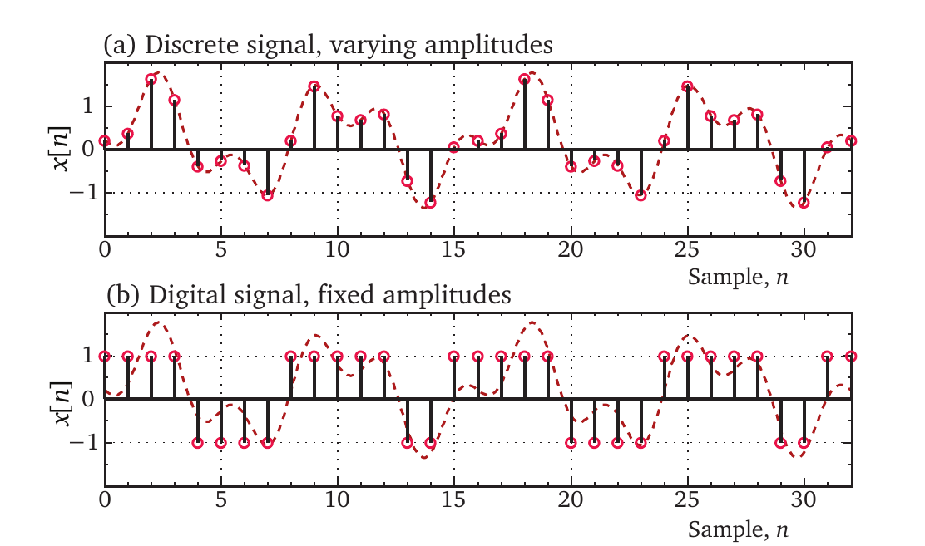
Sampling of analog signals to create discrete signals
Discrete vs. Digital

Slide 29
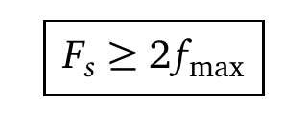
Creating a discrete signal from a continuous signal by sampling
You must sample a signal at a rate that is at least two times the maximum frequency in the signal.
Or you will get aliasing.

Slide 30
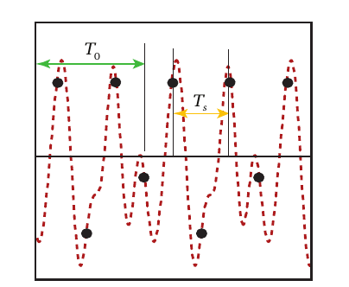
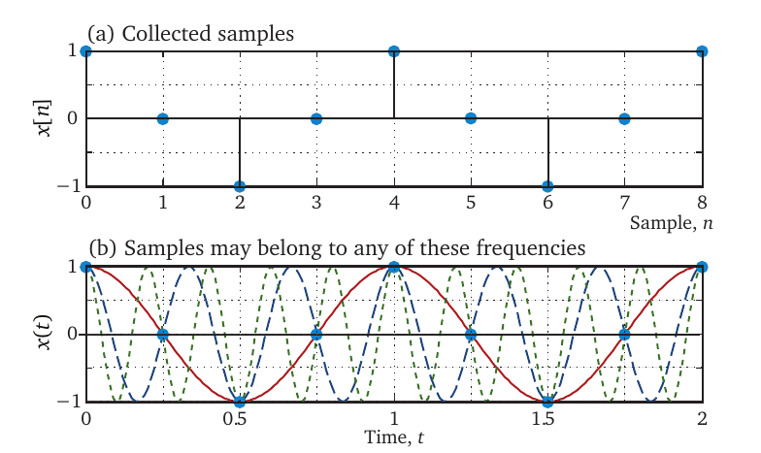
Aliasing – a consequence of improper sampling
The sampling period, Ts is the time period between samples. There is no relationship between the sampling period and the fundamental period, T0 of the signal. They are independent quantities.
Here are some samples. To which frequency do they belong?
https://www.quora.com/What-is-Aliasing-in-digital-communication/answer/Charan-Langton-1?__nsrc__=4&__snid3__=4388028371

Slide 31
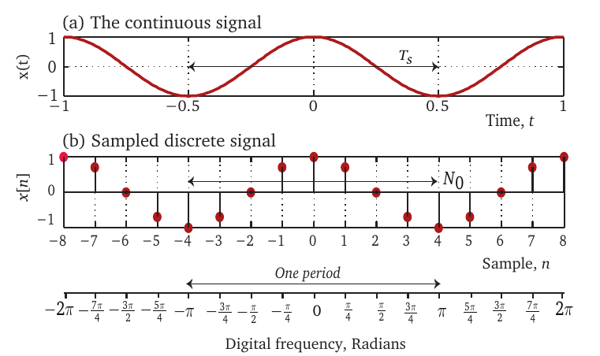
Concept of digital frequency for discrete signals
To - time period of a CT signal
N0 - number of samples for a DT signal

Slide 32
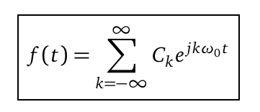
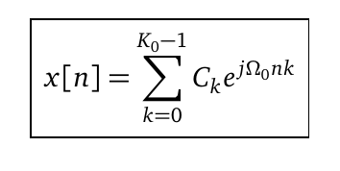
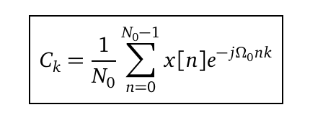
Discrete form of FSE
Fourier Series for continuous periodic signals
Fourier Series for discrete periodic signals

Slide 33
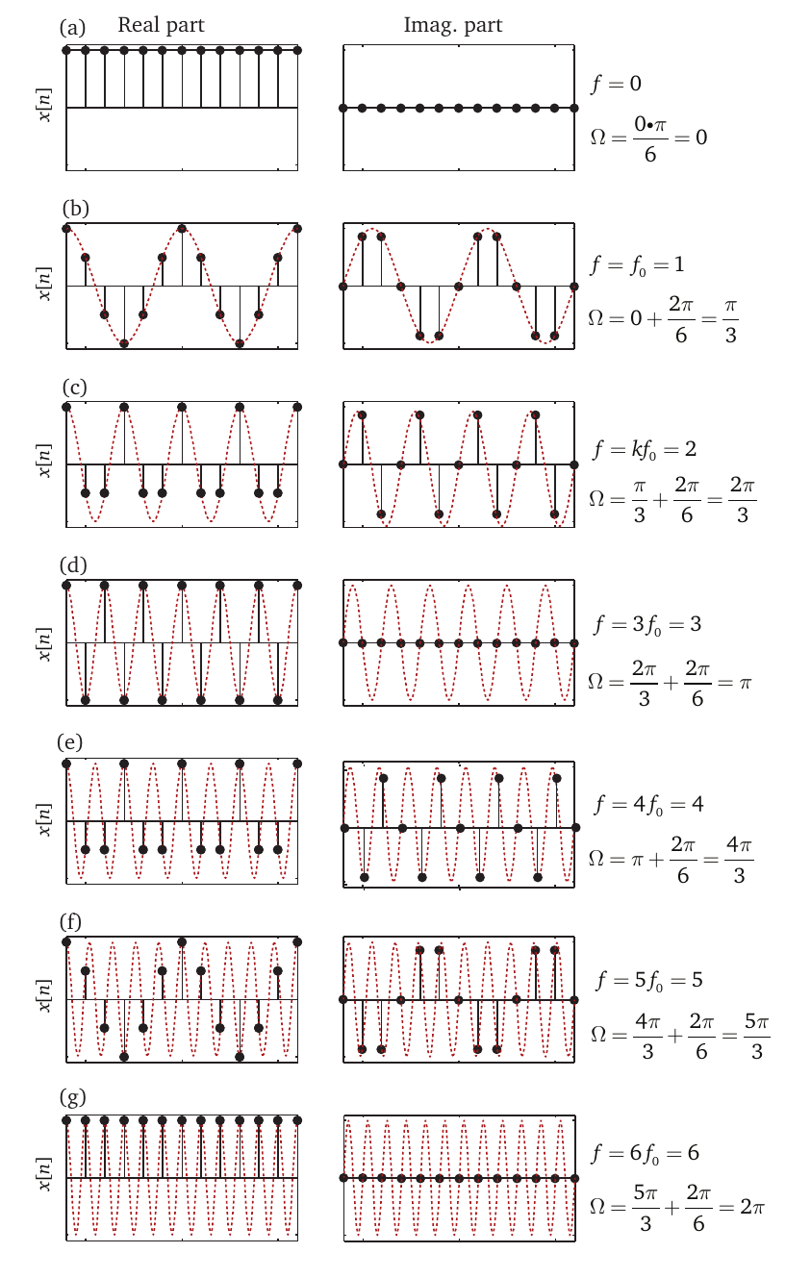
Discrete harmonics
Whereas harmonics for a CT signal are an integer times the fundamental, k fo.
For DT signals, the idea of harmonics is different and often confounding.
There are only N – unique harmonics of a DT signal that is periodic with N samples.
These are termed by Ko, but are same a No.
Because of this, the coefficients repeat every Ko harmonics.

Slide 34
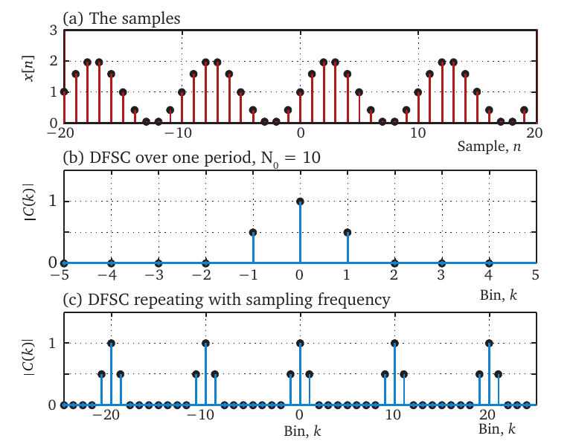
A DT signal has a double sided spectrum of repeating coefficients.
The discrete signal with period = 10 in (a),
(b) the fundamental spectrum, (c) the true repeating spectrum.

Slide 35
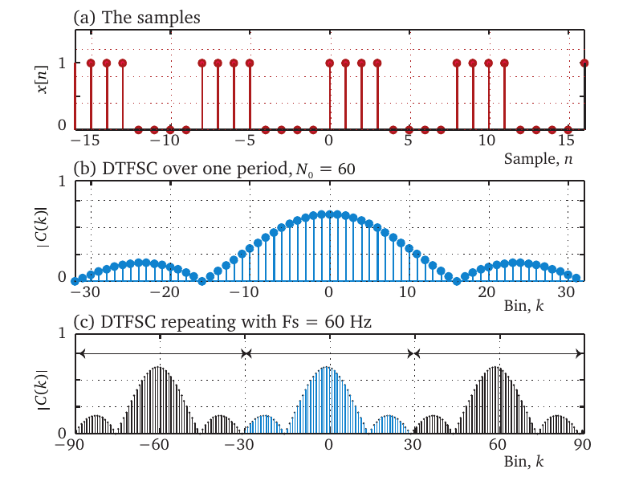
A DT signal has a double sided spectrum of repeating coefficients.
The discrete signal with period = 10 in (a),
(b) the fundamental spectrum, (c) the true repeating spectrum.

Slide 36
The Fourier Series vs. the Fourier Transform
Fourier series
Continuous, periodic signals – has a discrete single-sided spectrum
Infinite harmonics
Continuous , periodic complex version – has a discrete but two-sided spectrum
Infinite harmonics
Discrete periodic signals – has a discrete repeating spectrum
Only Ko unique harmonics
So what to do if the signal is NOT periodic.

Slide 37
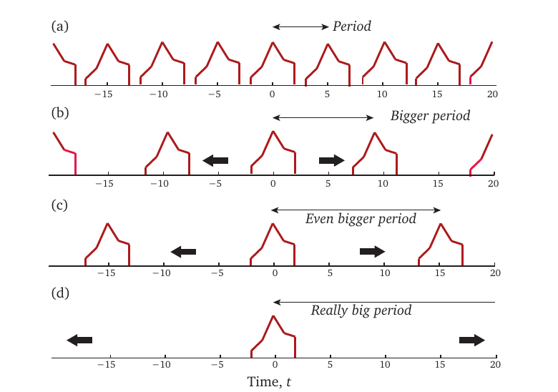
Period of a periodic signal
We need a period to compute the Fourier series coefficients.
The period of a non-periodic (aperiodic) signal can be conceptually extended in the limit to infinity.
Now we can apply the Fourier series equation to aperiodic signals by setting the period to infinity.

Slide 38
CT aperiodic signals have continuous coefficients (spectrum).
As we increase the period in (b), i.e., allow more time between the pulses, the fundamental frequency gets smaller, which makes the spectral lines move closer together as in (c).
In the limiting case, where the period goes to the spectrum becomes continuous.
Hence, FT of a CT (FTCT) signals is continuous, unlike FSC which are discrete.

Slide 39
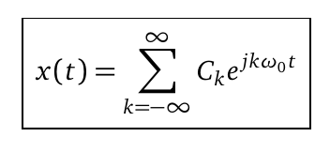
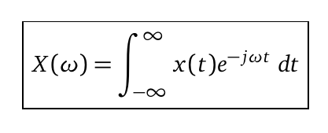
Fourier transform (CTFT) is a modified version of Fourier series,
without a period and no concept of a fundamental frequency.
Fourier series
Fourier series coefficients
Fourier series/transform, non-periodic
Fourier transform

Slide 40
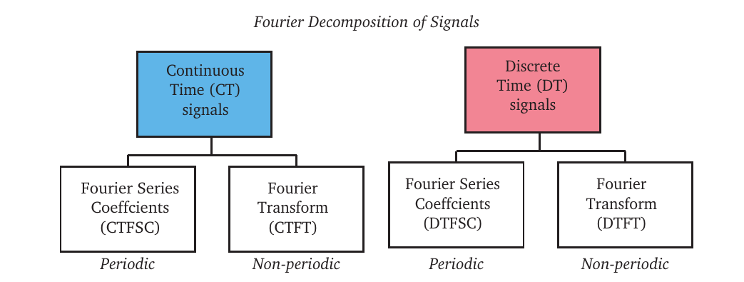
Comparing FS and FT

Slide 41
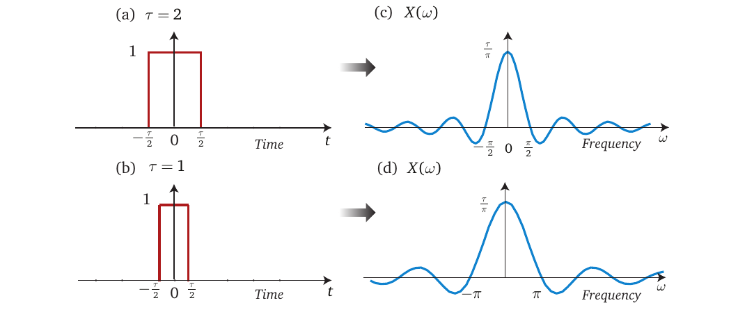
CTFT of a lone square pulse

Slide 42
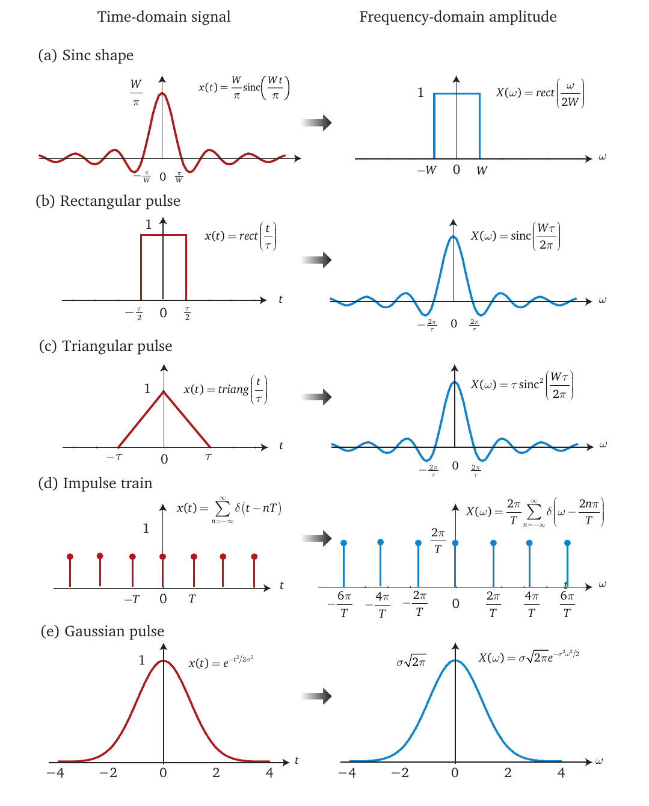
Some important CTFTs

Slide 43
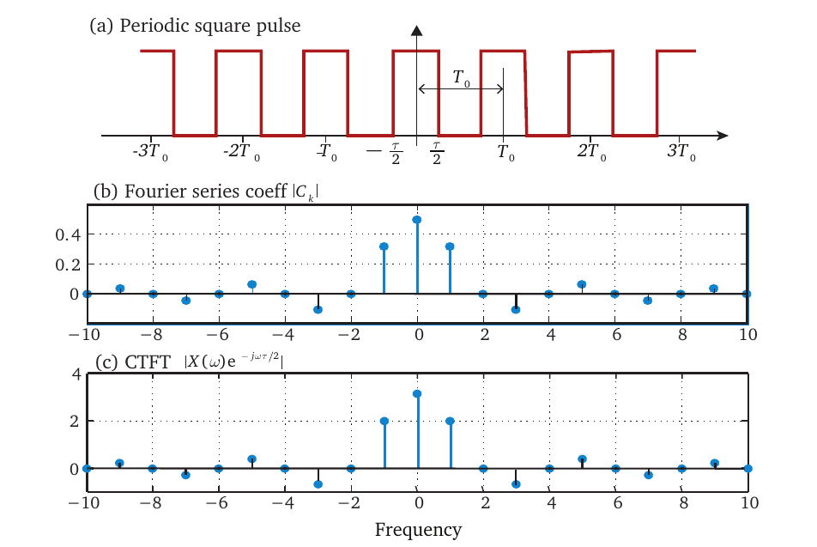
CTFT also applies to periodic signals.
CTFT gives only relative amplitudes.
The CTFT of a periodic signal can be considered a sampled version of the FSC. Because FSC are discrete, so is the CTFT for a periodic signal.
Unlike the CTFT of an aperiodic signal which is continuous, the CTFT of a periodic signal is discrete with the frequency resolution equal to the signal frequency.

Slide 44
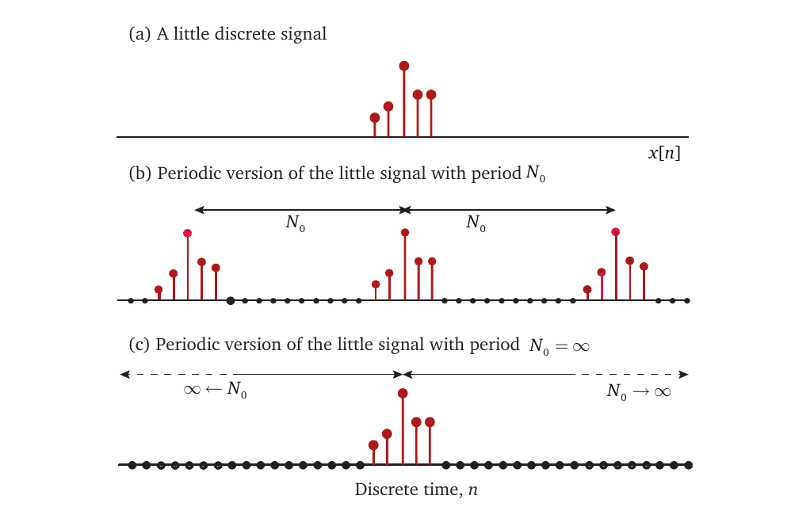
What about aperiodic DT signals?
We do the same thing we did with CTFT, but now we extend the discrete period to infinity.
In DTFT, there is no period.
All we have is the length of the signal. What we have is the period of the signal.
We have no idea what the signal looks like outside this length.

Slide 45
CT vs. DT signals Fourier transform
Aperiodic, CT signals
Aperiodic, DT signals

Slide 46
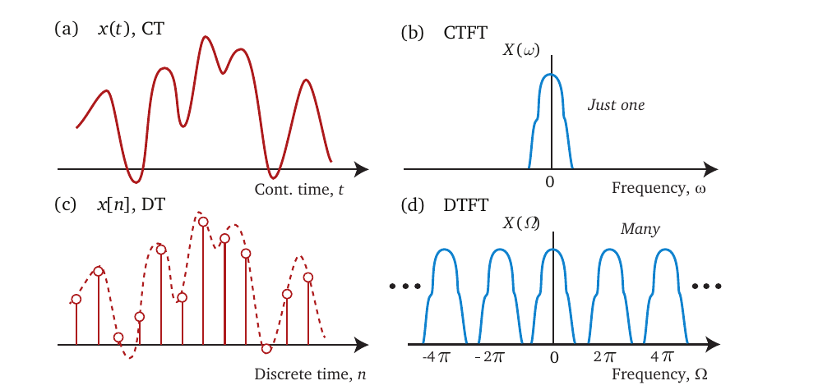
Comparing CTFT with DTFT
CTFT is continuous
Non-repeating
DTFT is also continuous but
Repeats

Slide 47
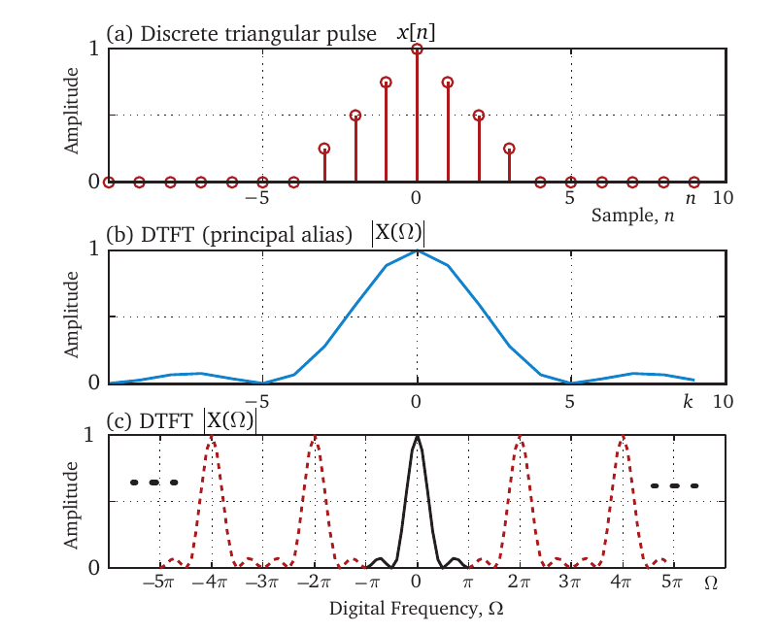
DTFT of a triangular pulse

Slide 48
DTFT of a periodic signal

Slide 49
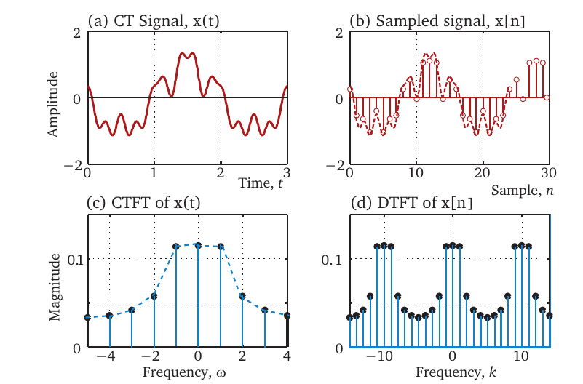
Comparing CTFT and DTFT for periodic signals.
Compare the CTFT of the CT signal in (c) with the DTFT of the same signal in (d). The DTFT looks the same as the CTFT but repeats.

Slide 50
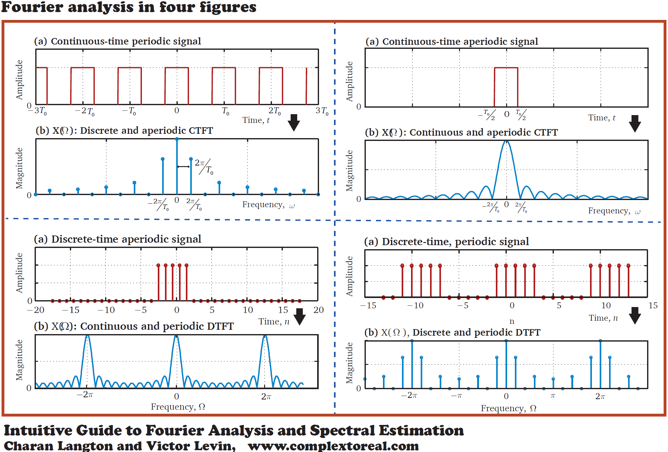
The input signal of case 4 fits closest to physical signals.
DTFT of such a signal is continuous, an undesirable quality
The discrete form of the spectrum of case 4 is preferable.
There is a way to combine these two cases. This is where the DFT comes in.
We take a signal, and call all its samples, its period.
Hence, the length of the signal samples is presumed to be its period.
Now, this aperiodic signal becomes a periodic signal of period N.
The DTFT as shown in case 4, for such a case is discrete.
Although it is still a DTFT, we call it a Discrete Fourier transform (DFT).
Hence, DFT takes an aperiodic input signal of case 3 but by assuming that it is actually a periodic signal, returns the discrete spectrum of case 4. This is a useful transformation!

Slide 51
DFT is DTFT on a finite length signal
The DFT borrows elements from both the discrete Fourier series and the Fourier transform.
DFT can be done on any arbitrary finite-length, uniformly sampled signal.
There is no need to know the real period of the signal, only the sampling frequency.
The DFT is easy to carry out in software.
The spectrum produced by the DFT discrete, unlike DTFT.

Slide 52
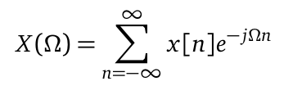
DFT is a sampled version of the DTFT

Slide 53
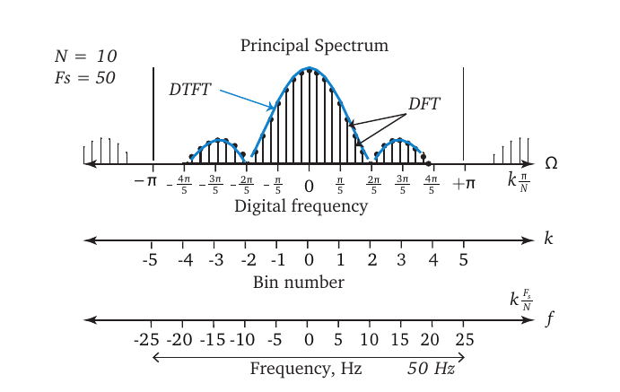
Understanding DFT x-axis

Slide 54
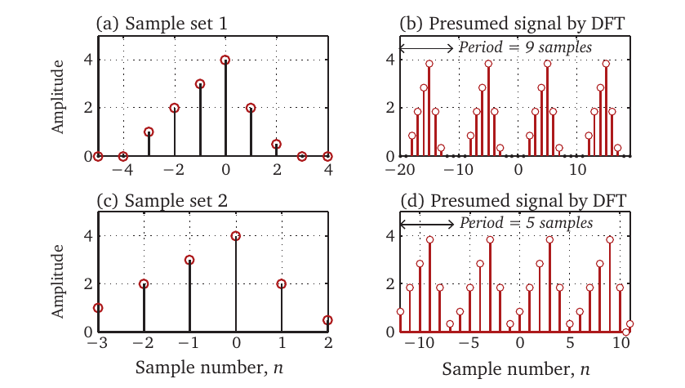
It takes whatever you give it as the period.

Slide 55
DFT as a sampled version of DFT, sampled at N points.

Slide 56
Zero-padding

Slide 57
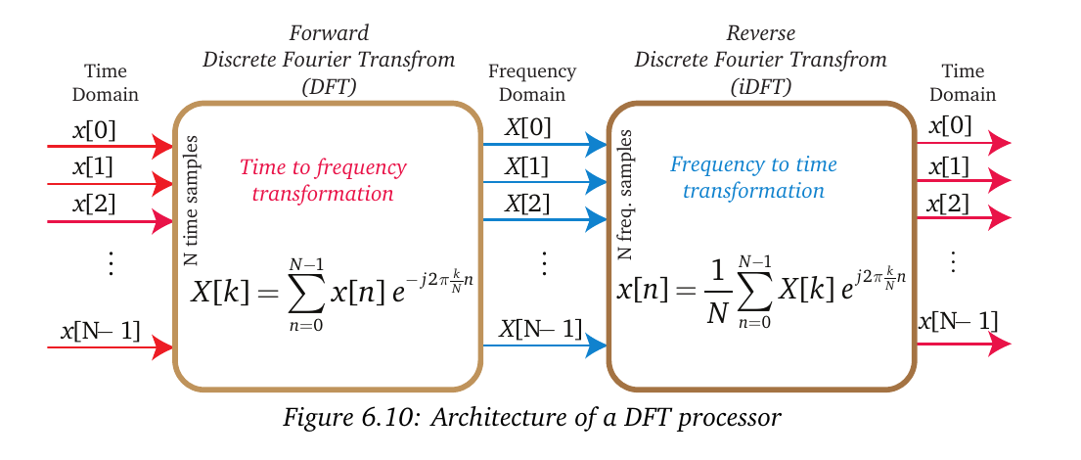
What DFT does

Slide 58
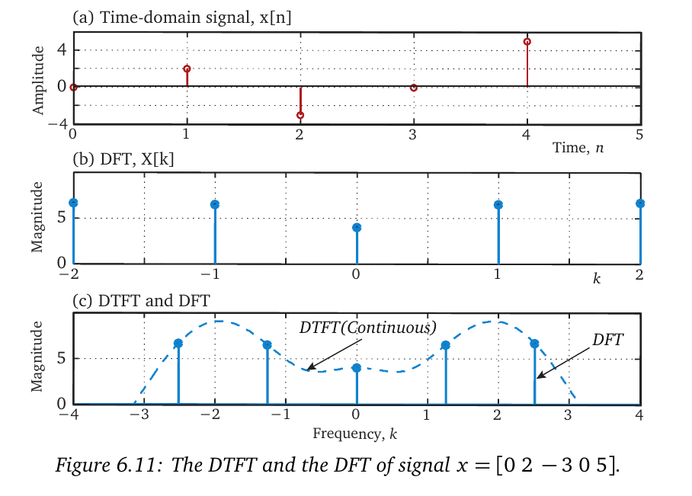
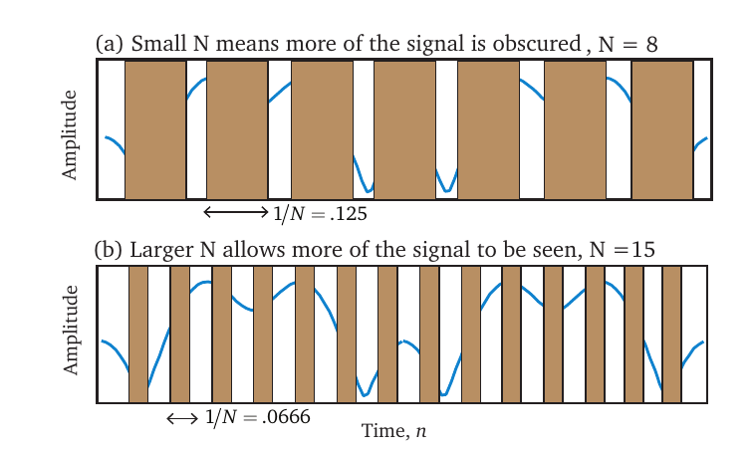
Adding a bunch of zeros at the end of the signal improves the resolution.

Slide 59
Increase N, the DFT size, with zero padding, for better spectrum

Slide 60
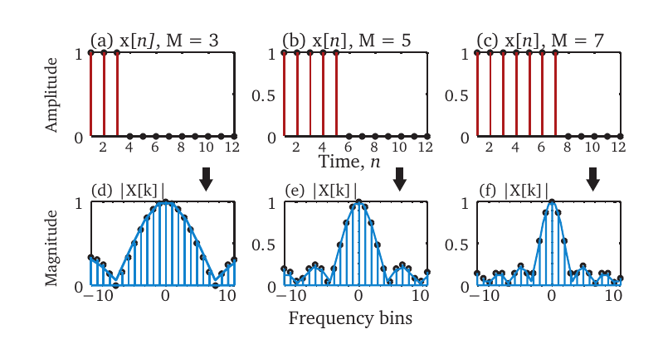
FT of a square pulse

Slide 61
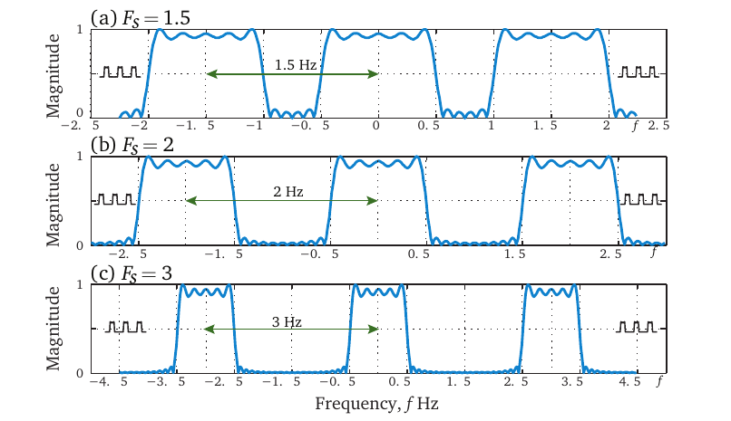
DFT repeats with sampling frequency

Slide 62
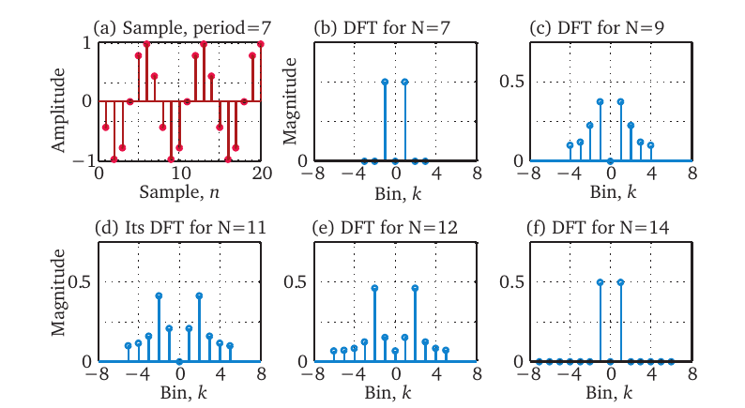
Leakage
The DFT of samples of a sinusoid of f = 1 Hz and N = 7, i.e. Fs = 7.
The DFT of the for N = 7 in (b) results in an ideal response.
When N is 9, 11 and 12, the result is noisy and not ideal as in (c), (d) and (e).
The DFT is again ideal when N = 14 as in (f).

Slide 63
Leakage
When the number of samples in the DFT are not an integer multiple of the number of samples per cycle.
Or, when the end of the signal do not match and there is a discontinuity. It is a consequence of truncation.
Both of these are the same thing.
A perfect DFT requires that the size of the DFT (N) be exactly equal to integer maultiple of the sampling frequency.
This is called Leakage.
The spectrum appears to be leaking into adjacent bins.

Slide 64
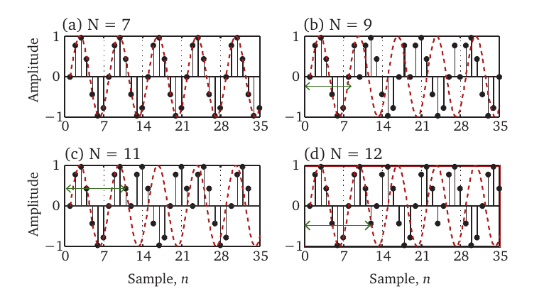
Leakage seen another way as discontinuity, Fs = 7, f = 1

Slide 65
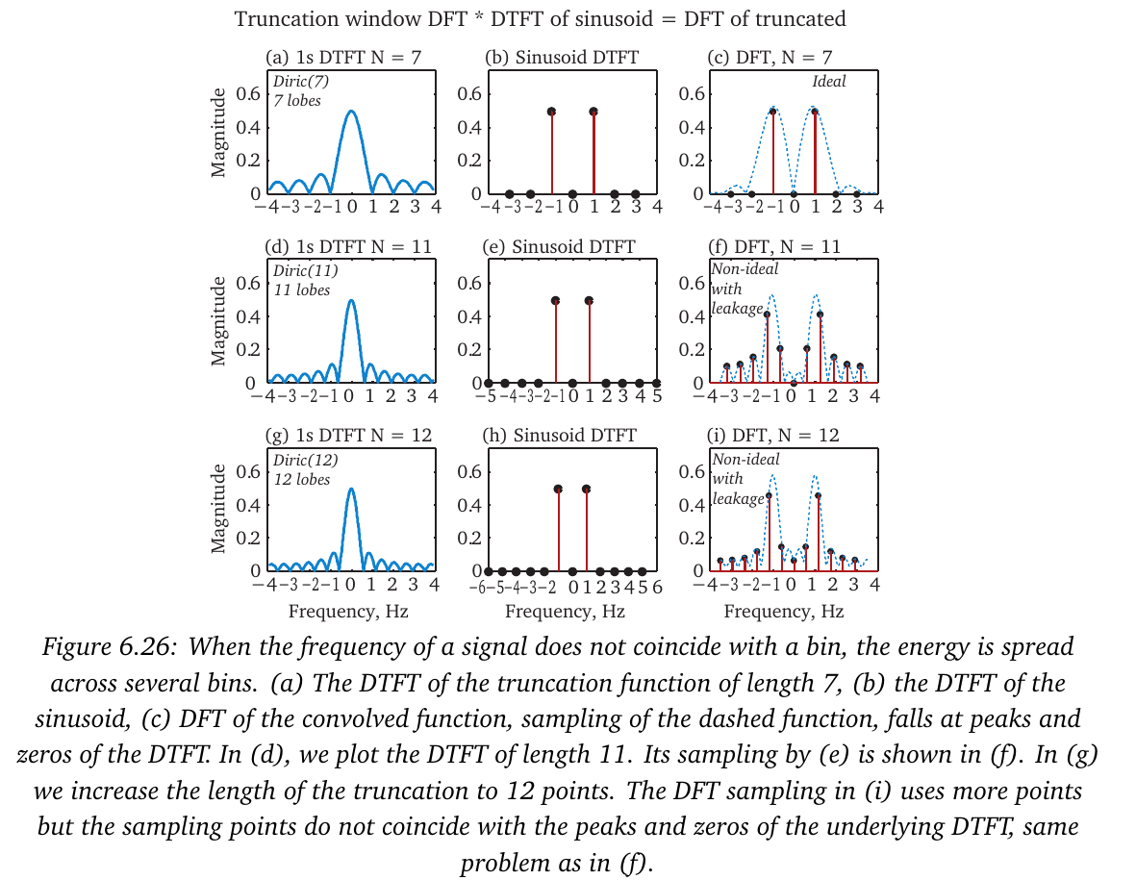
Truncation

Slide 66
What can we do about leakage
Do longer DFT
Use a Window

Slide 68
Fast Fourier Transform (FFT)
FFT is a special fast algorithm for computing the DFT, with N a power of 2. 4, 8, 256, 1024, etc.
The DFT although easy to compute, requires a good number of calculations. For each harmonic, we have N multiplications and we do this N times, giving us approximately N^2 calculations, referred to as multiply-and-accumulate (MAC) operations in DSP. A 256-point DFT would require $65,792 calculations.
In 1965, Cooley and Tukey came up with a computational breakthrough called the Fast Fourier transform algorithm.
This was an ingenious manipulation of the inherent symmetry in the calculations. It is now used so commonly that DFT is very often known by the name FFT.

Slide 69
Conditions for the existence of a FT
FT does not exist for all signals.
Random signals are a class of signals, for which the FS and FT are not always valid.

Slide 70
Autopower and Periodogram
We find that although the direct FT of a random signal may not exist, the FT of its auto-correlation function always exists.
So we have two ways of computing a power spectrum.
The square of the DFT – Periodogram
The DFT of the ACF - Autopower

Slide 71
The biased form of the ACF

Slide 73
Autopower(Corellogram)

Slide 74
Parameters of Autopower

Slide 75
Lag size effect

Slide 76
Periodogram

Slide 77
Windowing the Autopower

Slide 78
Signal size effect on Periodogram

Slide 79
Window effect in Periodogram

Slide 80
Improving Periodogram by averaging realization

Slide 81
Bartlett and Welch methods to improve Periodogram
Averaging a number of periodogram was first proposed by Bartlett. The algorithm cuts the signal into smaller sub-segments which results in a less noisy spectrum, i.e., with a smaller variance.
Split the N points into K segments of length M points each. For each segment, compute the periodogram by computing the DFT, then square the magnitude and divide by M. Average the result of all K segments to get the averaged periodogram.

Slide 82
Welch method
The Welch method is modification of the Bartlett method by using overlapping segments. The data segment is split into L data segments of length M, overlapping by D points. The overlap, D can be 0% to 50%.
Apply window to each segment, do the periodogram of each segment and average the results.
Many different versions of this idea are discussed in [Poularikas book, 2009].

Slide 83
Comparing Autopower and Periodogram
Ref: Hayes book

Slide 84
What to use
Use Autopower first
Use Periodogram, if Autopower not available
Must average several DFTs.
Results are usually acceptable.

Slide 85
Thank you.
Charan Langton
charldsp@gmail.com
Copyright Charan Langton
Please credit if using figures from this presentation.

Slide 86
References
[Langton2017] Intuitive Guide to Fourier Analysis and Spectral Estimation, Mountcastle Company 2017
[Brigham1988] Brigham, Oran E., Fast Fourier Transform, FFT and its Applications'', Prentice Hall, 1988.
[Gleason1995] Gleason, Alan., `Who is Fourier, A Mathematical Adventure'' Translational College of Lex, Language Research Foundation, Boston, 1995.
[Hayes1996] Hayes Monson H.Statistical Digital Signal Processing and Modeling, (1996), John Wiley \& Sons.
[Kay1988] Kay, Steven M., Modern Spectral Estimation, Theory and Applications, Prentice Hall, 1988.
[Lathi1998] Lathi, B. P., Modern Digital and Analog Communications. 3rd Edition, Oxford University Press, 1998.
[Lyons2013] Lyons, Rick., “Understanding Digital Signal Process'', Prentice Hall, 2013.
[Mandal2007] Mandal, Mrinal. and Asif, Amir., “Continuous and Discrete Time Signals and System'' Cambridge University press, 2007.
[Marks2009] Marks II, Robert J. , “Handbook of Fourier Analysis and its Applications'', Oxford University Press, 2009.
[Miller2004] Scott L. Miller, Donald G. Childers. Probability and Random Processes, Elesevier Inc., 2004.
[Mitra2006] Mitra, Sanit K., “Digital Signal Processing'', McGraw Hill, 2006.
[Oppenheim1997] Oppenheim, Alan V. and Willsky, Alan S. with S. Hamid Nawab., `Signals and Systems'', Second edition, Prentice Hall, 1997.

Slide 87
References – con’td
[Percival1993] Percival, Donald B and Walden, Andrew T, Spectral Analysis for physical Applications, Multi-taper and conventional Univariate Techniques, Cambridge University Press, 1993.
[Poularikas2009] Poularikas, Alexander D., “Discrete Random Signal processing and Filtering Primer with Matlab'', CRC press, 2009.
[Priestley1981] Priestley, M.B., “Spectral Analysis and Time Series'', Academic Press, 1981.
[Rorabaugh2011] Rorabaugh, C. Britton, `Notes on Digital Signal Processing'', Prentice Hall, 2011.
[Smith2007] Smith, III, Julius O. , “Mathematics of the Discrete Fourier Transform (DFT): with Audio Applications'', W3K Publishing, 2007.
[Schwartz1977] Schwartz, Mischa and Shaw, Leonard., “Signal Processing: Discrete Spectral Analysis, Detection and Estimation'', McGraw Hill, 1977.
[Stein2000] Stein, Jonathon (Y).,”Digital Signal processing, a Computer Science Perspective'', Wiley Interscience, 2000.
[Stoica1997] Stoica, Petre, Moses, Randolph, Introduction to Spectral Analysis, Prentice Hall, 1997.
[Tervo2014] Tervo, Richard J., “Practical Signal Theory with Matlab Applications'', Wiley Interscience, 2014.
[Therrie2012] Therrie, Charles W. and Tummala, Murali, Probability and Random Process for Electrical and Computer Engineers. CRC Press, 2012.

